Slide 1

Resume Analyzer System
Presented By
Alok Jha
Jayant Joshi
Pramod Singh
Date: 25th Jun, 2025

Slide 2
Outlines
Introduction
Problem Statement
Objective
Project Features
Applications
Methodology
System Block Diagram
Use Case Diagram
Testing and results
Output
Future Enhancement
Conclusion

Slide 3
Introduction
🎯 AI-Driven Resume Analysis: Automatically analyzes resumes using AI and NLP to extract skills, education, and experience for smarter evaluation.
🌐 Works Fully Offline: Designed to function without internet, making it accessible in classrooms, labs, and low-resource settings.
🎓 Practical + Educational Tool: Helps users improve career readiness and also serves as a learning tool to demonstrate real-world AI applications.

Slide 4
Problem Statement
Students often struggle to evaluate how well their resumes align with career goals.
Traditional resume reviews are manual, slow, and lack consistent feedback
Existing tools are costly, online-only, or limited to proprietary platforms
A need exists for an AI-powered offline tool to give personalized, automated feedback.

Slide 5
Objective
To develop a software system that analyzes resumes and extracts key information like skills, education, and experience using AI is our main aim.
To automate the resume evaluation process and provide personalized career and learning suggestions.
To maintain a secure, offline-accessible platform that stores and manages user resume data efficiently.

Slide 6
Features
Resume Upload: Users can securely upload resumes in PDF or DOCX format for analysis.
Skill and Experience Extraction: The system extracts key skills, education, experience, and relevant keywords using NLP.
Career Domain Prediction: Predicts suitable career fields based on resume content.
Learning Gap Identification: Detects missing skills or qualifications and suggests areas for improvement.
User Dashboard: Provides each user with a dashboard showing recent analyses and insights.
Reporting Generation: Generates downloadable PDF reports summarizing analysis results and recommendations.
Offline Functionality: Designed to run entirely on a local machine without internet.

Slide 7
Applications
Educational Tool: Used in colleges and training centers to teach students how resumes are evaluated.
Career Counseling: Assists counselors in analyzing students’ resumes and providing data-driven suggestions.
Student Portfolio Evaluation: Helps institutions and students evaluate academic and extracurricular achievements.
HR & Recruitment Simulation: Provides a risk-free environment to simulate resume screening processes.
Prototype for Career Platforms: Acts as a foundation for developing AI-powered career guidance platforms.
Offline Resume Analysis: Supports resume feedback in low-resource environments using a fully local system.

Slide 8
Methodology
Research & Analysis: Studied existing resume evaluation systems and identified gaps in automation, accessibility, and personalization.
System Design: Designed a modular architecture with components for resume parsing, skill extraction, and career prediction.
Development: Implemented the system using React, Tailwind CSS, Node.js, Python (Flask), MongoDB, and NLP tools like spaCy and NLTK.
Testing & Feedback: Performed functional testing, handled edge cases, and incorporated user feedback to enhance accuracy and usability.

Slide 9
Model Used
spaCy(en_core_web_sm):
Pre-trained en_core_web_sm model and NLTK for NLP tasks like tokenization, entity recognition, and POS(Part-of-Speech) tagging.
It applies rule-based logic and keyword matching to extract skills, predict career domains, and suggest learning improvements.

Slide 10
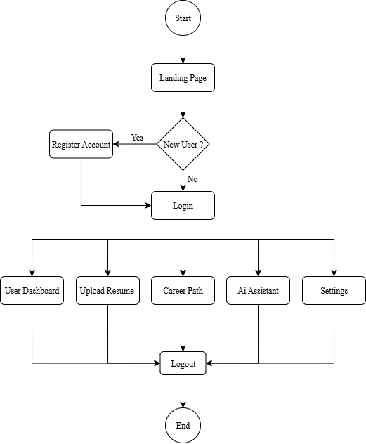
System Flow Diagram
Fig 1: Flow Diagram

Slide 11
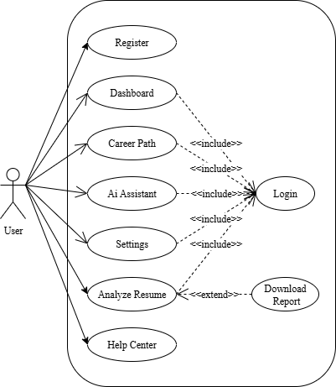
Use Case Diagram
Fig 1: Use Case Diagram

Slide 12
Testing and Results
Testing Methods:
Unit Testing:
Tools: Pytest
Tested API endpoints, AI functions, output formats
Integration Testing:
End-to-end test: Resume upload → analysis → result display
Ensured modules communicate properly (frontend ↔ backend ↔ AI ↔ DB)

Slide 13
Testing and Results
Functional Testing:
Verified all key features: login, upload, chatbot, analysis
UI/UX Testing:
Manual testing on multiple screen sizes
Checked layout, navigation, and responsiveness
Security Testing:
Tested JWT protection, bcrypt password hashing, route protection
Usability Testing:
Feedback from 3 users
Improved layout and error messages based on feedback
Performance Testing:
Measured resume upload time, analysis speed, and UI response time

Slide 14
Output
The system is expected to perform key functions such as secure user login, resume upload, AI-powered skill extraction, and career prediction.
The user interface will be intuitive and easy to navigate.
The system will generate downloadable PDF reports summarizing each resume analysis.
User feedback is expected to reflect high satisfaction with the platform’s usability and usefulness, especially in academic environments.

Slide 15
Future Enhancements
Use advanced NLP with GPT/Transformer models
Multi-language resume support
LinkedIn profile analyzer integration
Real-time job openings matching

Slide 16
Conclusion
The AI-Powered Resume Analyzer simplifies and improves resume screening using artificial intelligence.
It combines frontend and backend technologies with machine learning to deliver fast, personalized career advice and insights.
The system is user-friendly, scalable, and solves a real-world problem for both job seekers and recruiters.

Slide 17
References
[1] F. Chollet, Deep Learning with Python, 2nd ed. Shelter Island, NY, USA: Manning Publications, 2021.
[2] S. Bird, E. Klein, and E. Loper, Natural Language Processing with Python: Analyzing Text with the Natural Language Toolkit. Sebastopol, CA, USA: O’Reilly Media, 2009.
[3] ExplosionAI, “spaCy: Industrial-strength Natural Language Processing in Python,” [Online]. Available: https://spacy.io. [Accessed: Jun. 25, 2025].
[4] R. Burke, “Hybrid Recommender Systems: Survey and Experiments,” User Modeling and User-Adapted Interaction, vol. 12, no. 4, pp. 331–370, 2002.
[5] M. Pazzani and D. Billsus, “Content-Based Recommendation Systems,” in The Adaptive Web, Berlin, Germany: Springer, 2007, pp. 325–341.
[6] B. Sarwar, G. Karypis, J. Konstan, and J. Riedl, “Item-based Collaborative Filtering Recommendation Algorithms,” in Proc. 10th Int. Conf. World Wide Web (WWW), Hong Kong, China, 2001, pp. 285–295.

Slide 18
Thank You!

